Slide 1


SIMATS ENGINEERING
Saveetha Institute of Medical and Technical Sciences
Chennai-602105.
Intelligent Food Redistribution and Waste Reduction Network
Guided By:
Dr.Magesh Kumar
Presented By:
192425069 MANDEM NANDHINI
192511420 D MAHA LAKSHMI
192472318 GADIPUTIKOTLA VYSHNAVI
192325140 MALLIKE REDDY JAYASREE
192421158 MONIKA G

Slide 2

INTRODUCTION
The Intelligent Food Redistribution and Waste Reduction Network is an AI-based platform designed to bridge the gap between food donors and beneficiaries.
The system enables donors to register surplus food and allows NGOs, food banks, and volunteers to receive and distribute it efficiently.
Artificial Intelligence is used to match donors with the most suitable recipients based on factors such as location, food type, quantity, urgency, and expiry time.
Real-time tracking and automated notifications improve transparency and ensure timely food collection and delivery.
The platform also monitors food quality and expiry details to ensure that only safe and consumable food is distributed.

Slide 3
OBJECTIVES
To connect food donors with people who need food using an AI-based matching system.
To reduce food waste by collecting and distributing surplus food before it expires.
To track food donations in real time from donation to delivery.
To ensure food safety by checking expiry dates and food quality before distribution.
To optimize delivery routes so food reaches recipients quickly and with lower transportation costs.
To send automatic notifications to donors, volunteers, and recipients about donation and delivery updates.
To encourage community participation by providing an easy-to-use platform for individuals and organizations to donate surplus food.

Slide 4
PROBLEM STATEMENT
Large quantities of edible food are wasted every day by restaurants, hotels, supermarkets, and households.
Millions of people continue to suffer from hunger and food insecurity despite the availability of surplus food.
Existing food donation systems are often manual, unorganized, and inefficient, causing delays in food distribution.
There is no intelligent mechanism to match food donors with the nearest and most suitable recipients in real time.
Lack of proper coordination between donors, NGOs, volunteers, and beneficiaries results in missed donation opportunities.
Perishable food often expires before it can be collected and distributed.
Many organizations lack real-time tracking of food donations, pickup, delivery, and distribution status.
Food safety is difficult to ensure due to inadequate monitoring of expiry dates, storage conditions, and food quality.

Slide 5
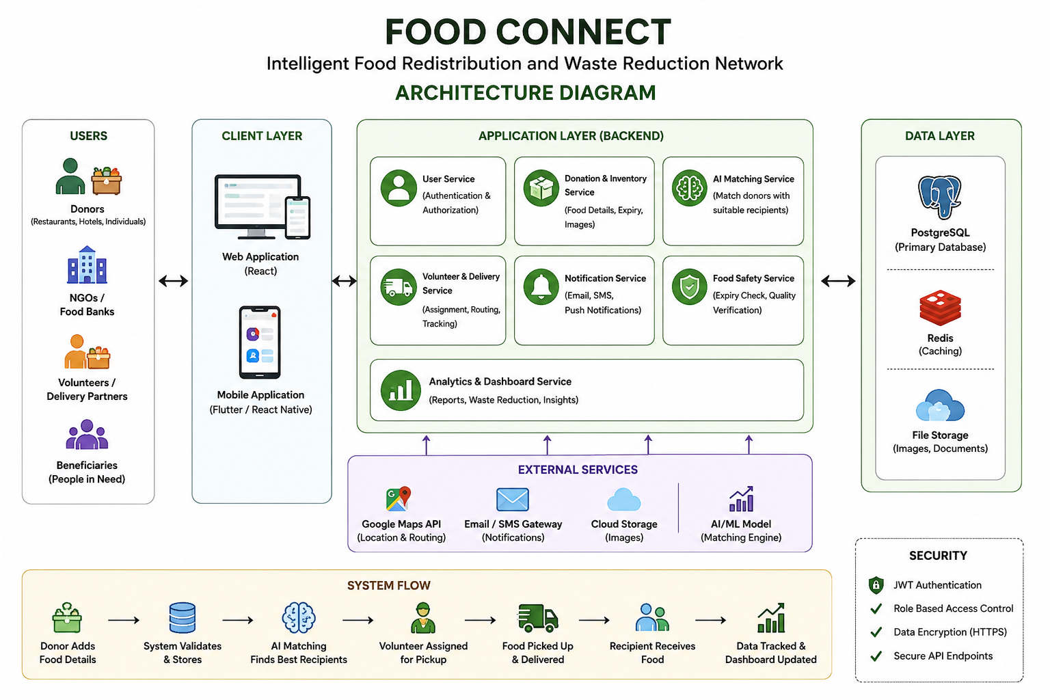

Slide 6
LITERATURE REVIEW
Module / Aspect | Key Concepts | Techniques / Methods | References / Findings
Food Waste & Redistribution | Surplus food recovery, waste reduction, hunger mitigation | Digital food-sharing platforms, donor–recipient coordination | Aitken et al., 2024: Food recovery and donation systems can help reduce food waste while addressing food insecurity. (ScienceDirect)
Food Donation Platforms | Real-time donation registration, location-based food discovery, collection tracking | Web applications, maps, donor/receiver management | Sowmya Lakshmi et al., 2024: A web-based food donation platform can connect donors with charitable organizations and improve surplus-food redistribution. (DOI)
AI-Based Food Waste Reduction | Intelligent decision-making, waste prediction, surplus-food management | AI technologies, optimization, automated waste tracking | Cejas, 2025: AI-based technologies can support food-waste reduction, with surplus-food redistribution identified as a practical application. (MDPI)
Food Waste Monitoring | Real-time monitoring, spoilage detection, waste measurement | Computer vision, deep learning, automated tracking | 2025 study: AI-based waste-tracking devices using computer vision and deep learning achieved substantial reductions in food waste in several food-service settings. (PubMed)
AI-Based Matching & Redistribution | Donor-recipient matching, expiry awareness, demand and location analysis | AI, heuristic algorithms, smart-platform decision making | Maleki Vishkaei et al., 2026: Smart food-sharing platforms can use factors such as expiry date, transport cost, shelf life, donation rate and demand to improve redistribution decisions. (Wiley Online Library)
Food Redistribution & Route Optimization | Intelligent matching, freshness prediction, route optimization, traceability | AI/ML, image processing, geolocation, mobile applications | Thilagavathi et al., 2026: FoodShare Hub integrates freshness prediction, intelligent matching, route optimization and traceability for food redistribution. (AIJFR)
Equitable Food Allocation | Food-insecurity mapping, resource allocation, beneficiary prioritization | Machine-learning index, heuristic allocation | 2026 study: An end-to-end framework combined ML-based food-insecurity estimation with surplus-food allocation to improve equitable redistribution. (ScienceDirect)

Slide 7
Module 1
Food Donation & Inventory Management
Donors can add food details (food type, quantity, expiry date/time).
Upload food images for quality verification.
Real-time inventory tracking of available food.
Automatic expiry and freshness monitoring.
Update or cancel food donation requests.
Categorize food (Vegetarian, Non-Vegetarian, Vegan, Packaged, Cooked).
Specify pickup location using GPS/Google Maps.
Mention food preparation date and storage conditions.

Slide 8
Module 2:
AI-Based Food Matching & Redistribution
This module helps users understand their surroundings by identifying objects and people.
• Sensors Used: Camera (RGB or depth)
• Features:
• Recognizes traffic lights, crosswalks, doors, and familiar faces
• Reads text from signs, labels, or documents (OCR)
• Alerts users to dynamic changes (e.g., approaching vehicles)
• AI Role: Computer vision models for object detection, facial recognition, and scene understanding

Slide 9
Module 3:
Voulnteer & Delivery Management
The system automatically assigns delivery tasks to the nearest available volunteer.
AI-based algorithms consider location, travel distance, estimated delivery time, traffic conditions, and food expiry time.
High-priority donations receive immediate assignment.
Multiple deliveries in nearby locations can be assigned to the same volunteer to reduce travel time.
Volunteers receive complete pickup information including donor name, address, contact details, food quantity, and pickup time.
The system generates a digital pickup request.
Volunteers confirm arrival at the donor's location.

Slide 10
Module 4
Analytical & Waste Monitoring Dashboard
Monitors the overall performance of the food redistribution system.
Collects and analyzes data from donors, volunteers, NGOs, and deliveries.
Provides real-time insights through dashboards, charts, and reports.
Helps administrators make better decisions to reduce food waste.
Tracks food donations, deliveries, volunteer activities, and beneficiary information.
Tracks the number of NGOs and beneficiaries served.
Displays data using bar charts, pie charts, line graphs, and dashboards.

Slide 11
FUTURE SCOPE
AI-Based Matching: Improve donor and beneficiary matching based on location, food type, quantity, urgency, and expiry time.
Real-Time Tracking: Track food pickup, delivery, and distribution status in real time.
Route Optimization: Use GPS and traffic information to select efficient delivery routes.
Food Quality Monitoring: Add sensors and image-based analysis to monitor freshness and storage conditions.
Mobile Application: Develop a mobile app for donors, NGOs, volunteers, and beneficiaries.
Predictive Analysis: Predict food surplus and identify areas with higher food-waste levels.
Wider Deployment: Expand the system to more restaurants, supermarkets, NGOs, and cities.

Slide 12
CONCLUSION
Connects food donors, NGOs, volunteers, and beneficiaries through a single platform.
Helps reduce food wastage by collecting and redistributing surplus food before expiry.
Supports AI-based matching to connect available food with suitable recipients.
Improves pickup and delivery coordination through volunteer management.
Provides real-time tracking and notifications for better communication and transparency.
Supports food safety, expiry monitoring, and analytical reporting.
Overall, Food Connect provides a smart, efficient, and sustainable solution for food redistribution and food security.

Slide 13
THANK YOU

